Slide 1
Daakiya (डाकिया)
Route Optimization, Planning and Management for Last Mile Trips
Chirag Pandit
HERE Technologies - Mumbai

Slide 2
Process Model
Orders arrive in this system from various sources
Assignment for these orders into a trip keeping onto account some key factors like delivery timings and location preference
Control Tower personnel monitors the trip progress happening on ground

Slide 3
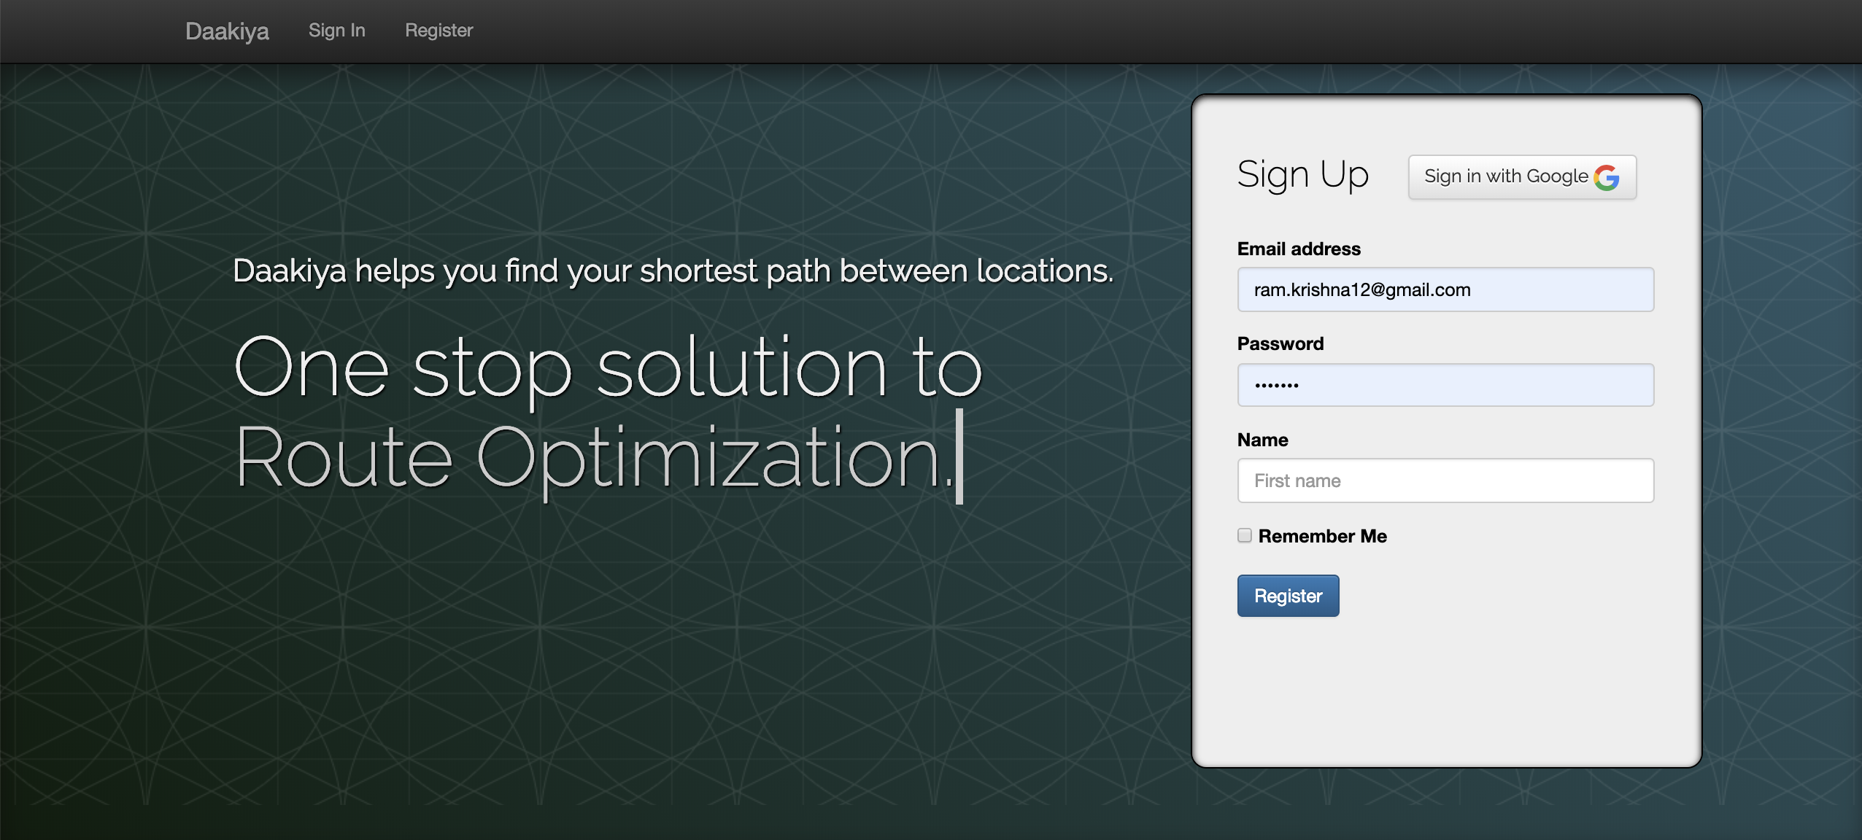

Slide 4
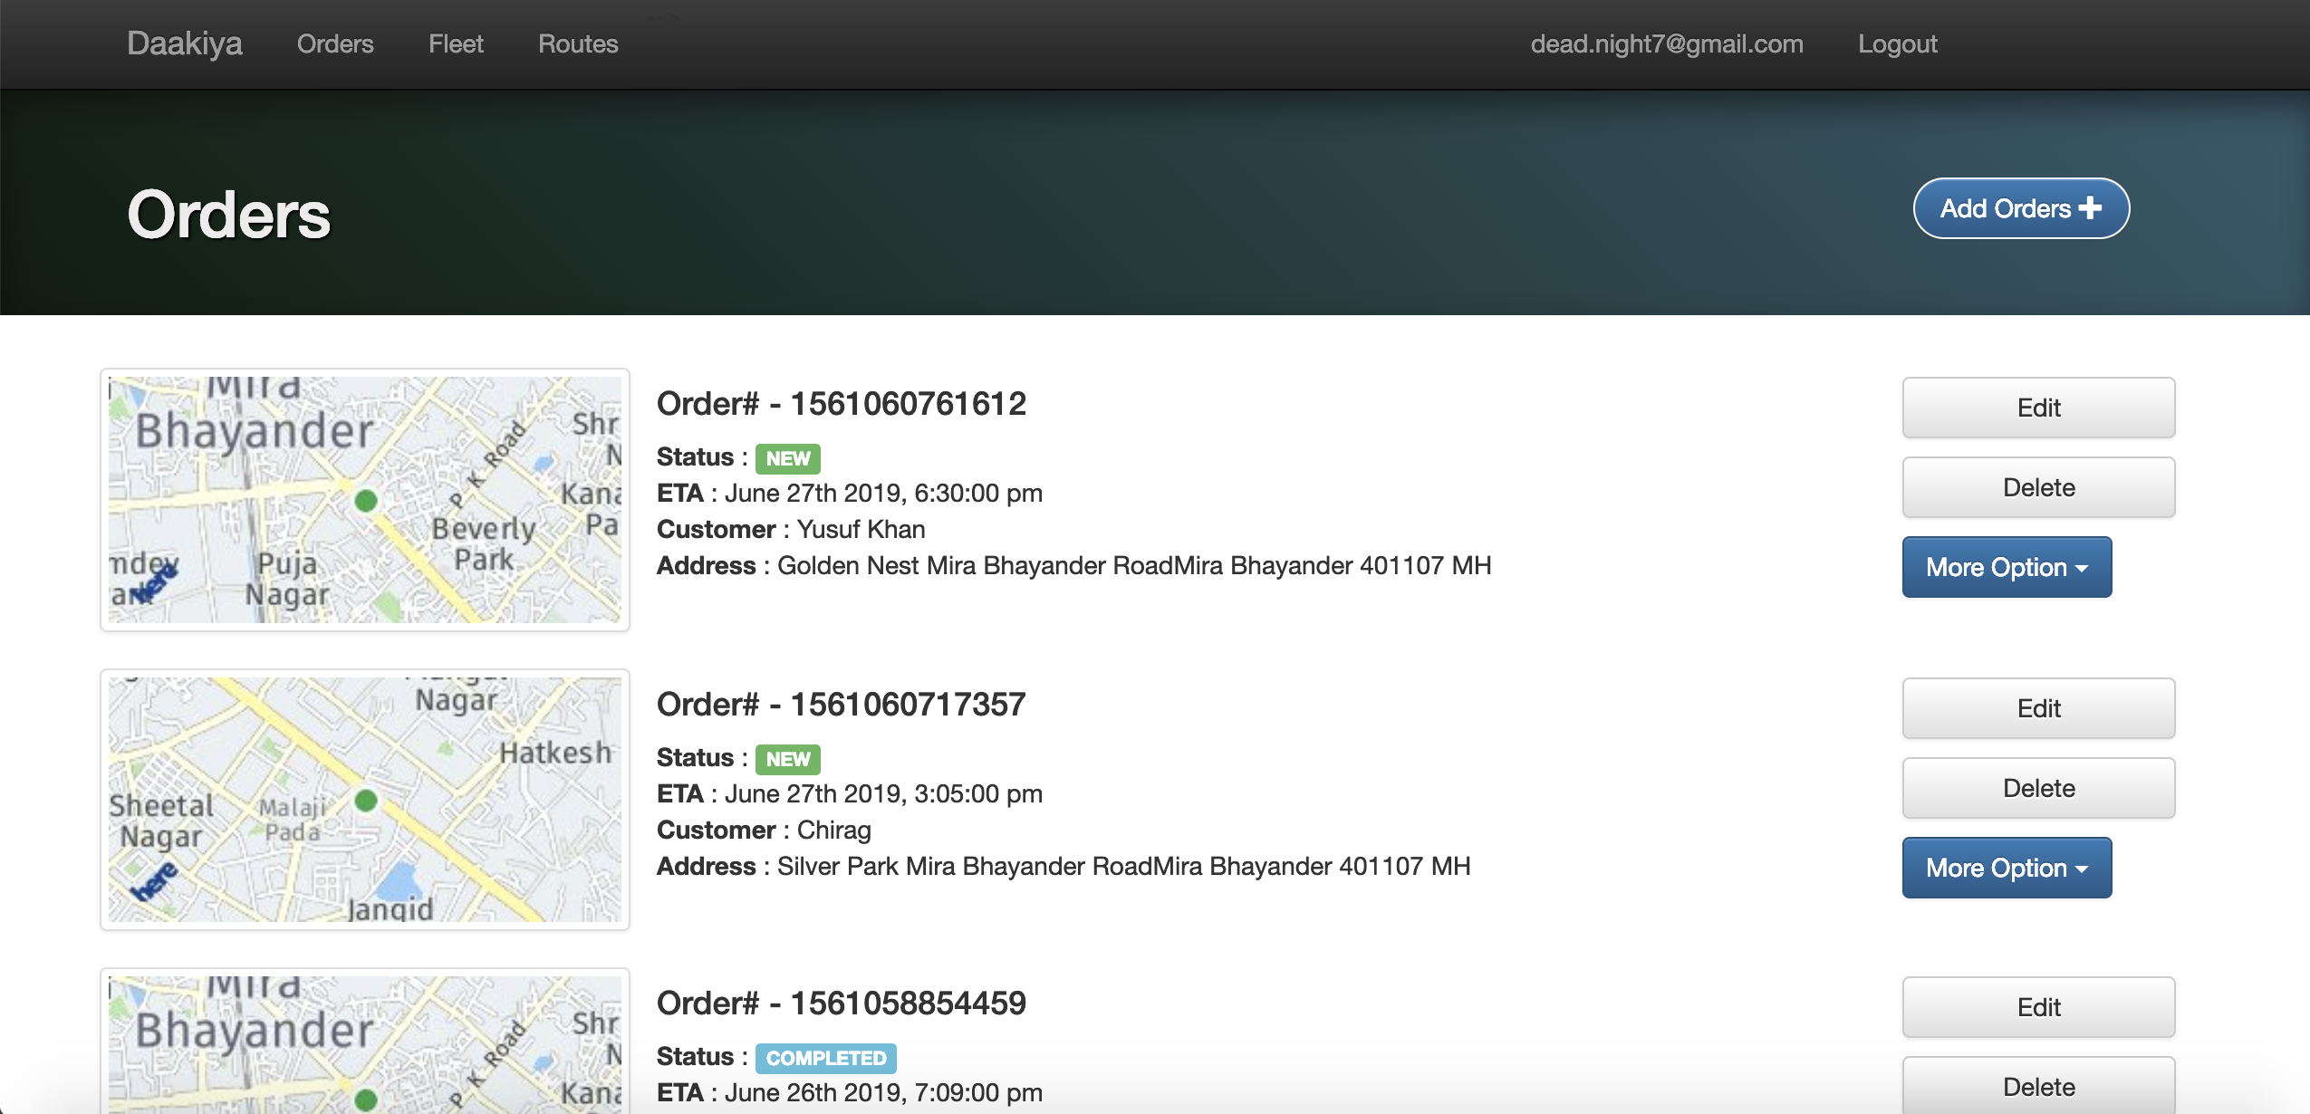

Slide 5
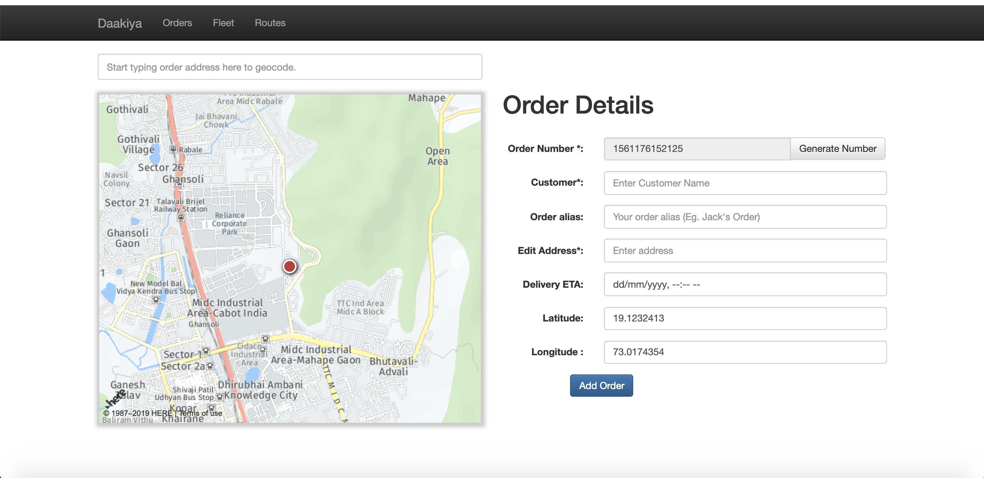
Add order form

Slide 6
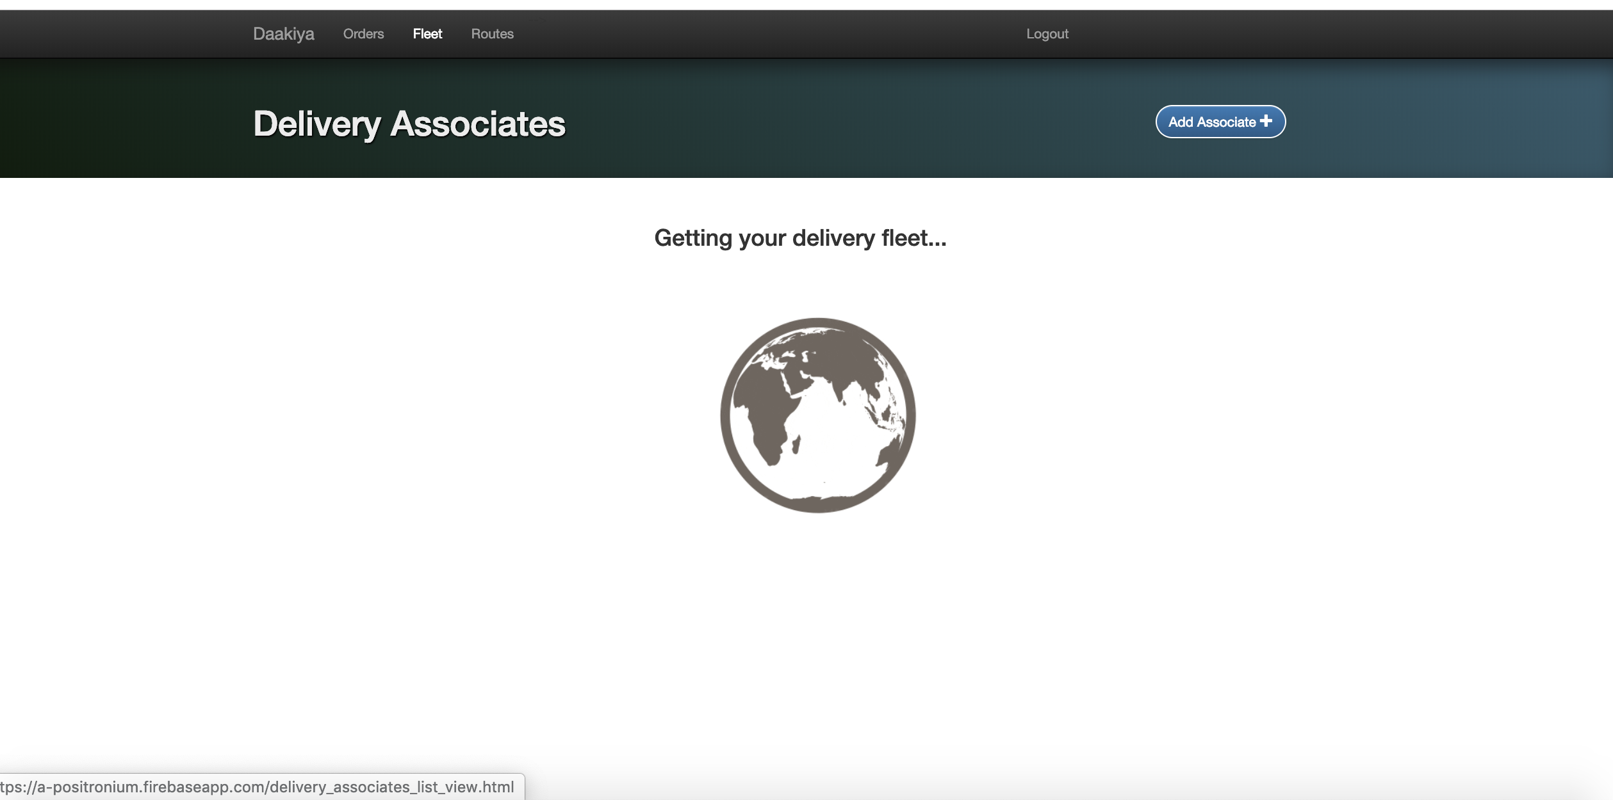

Slide 7
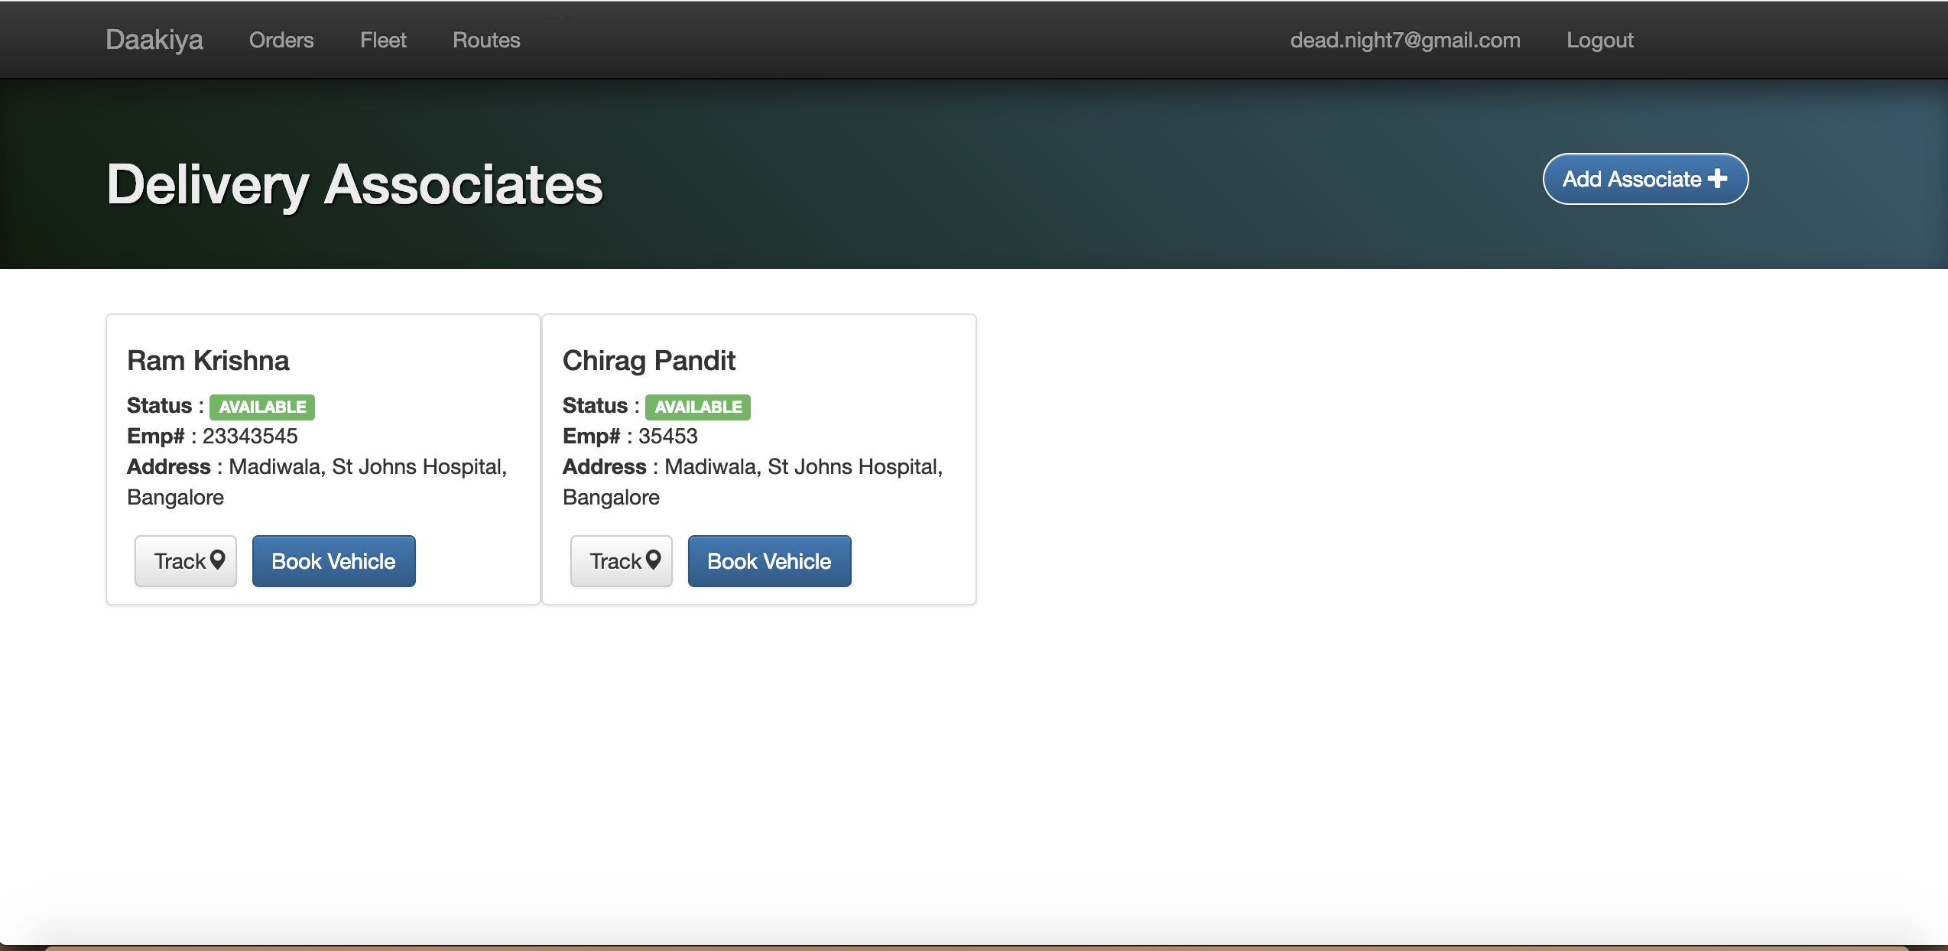

Slide 8
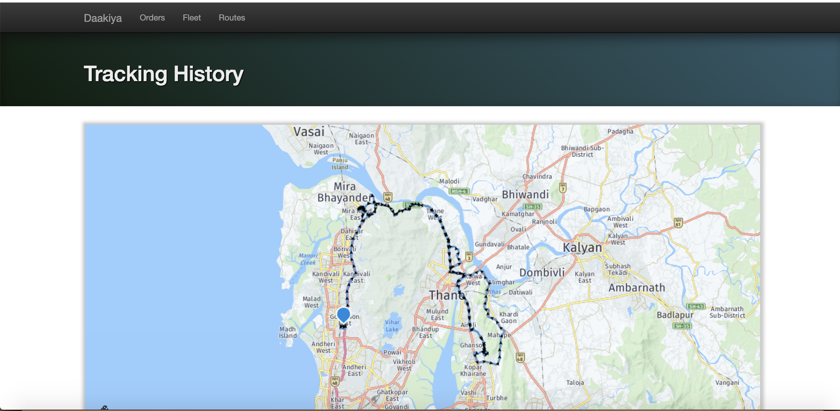

Slide 9
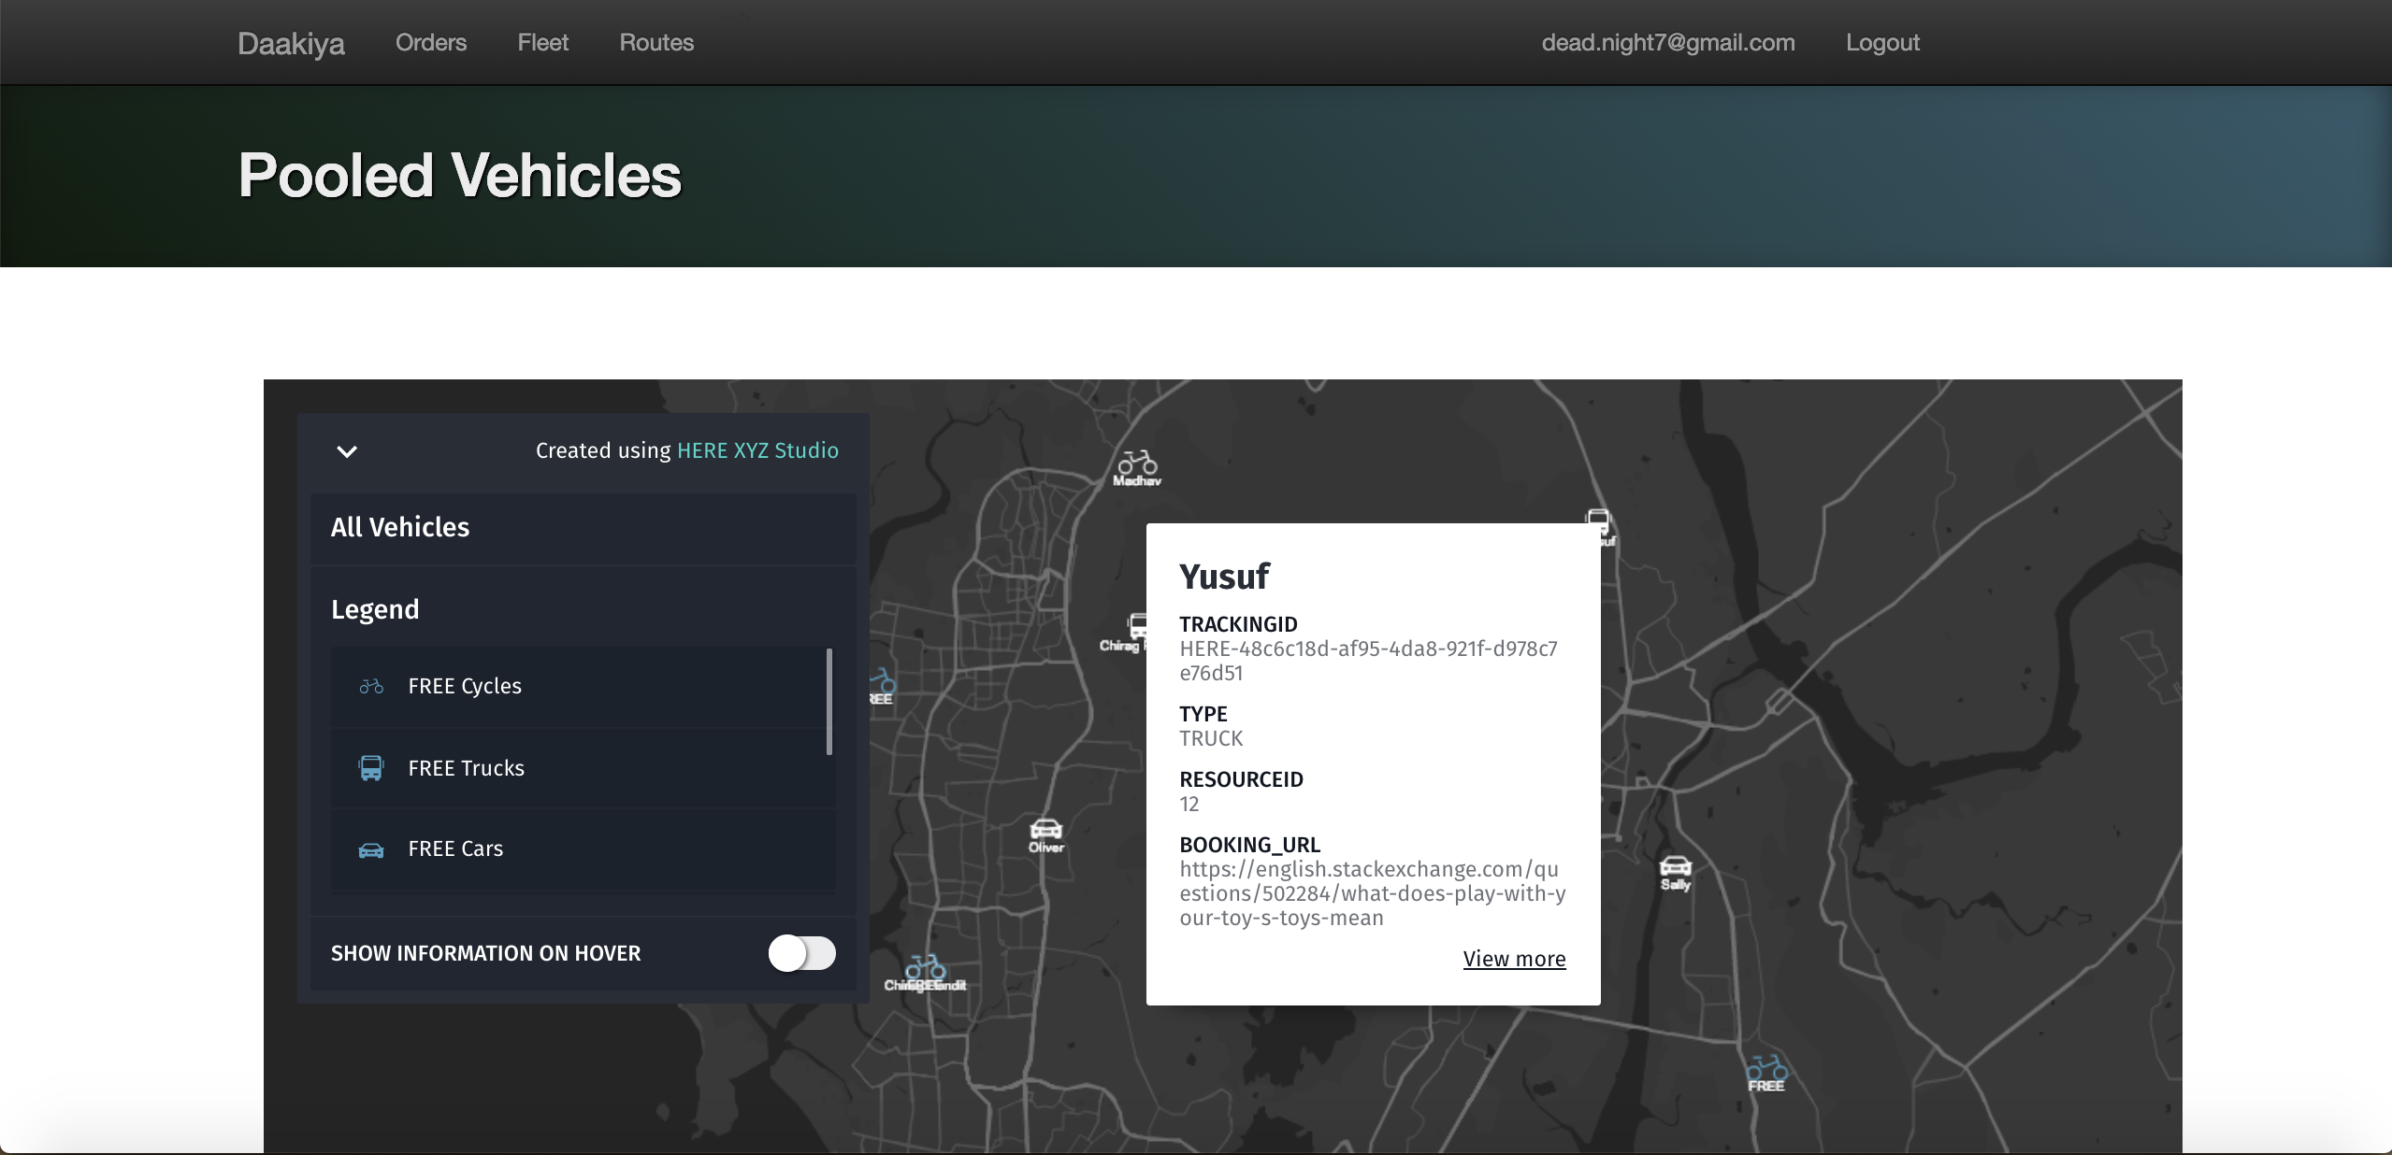
Vehicles data in HERE XYZ

Slide 10
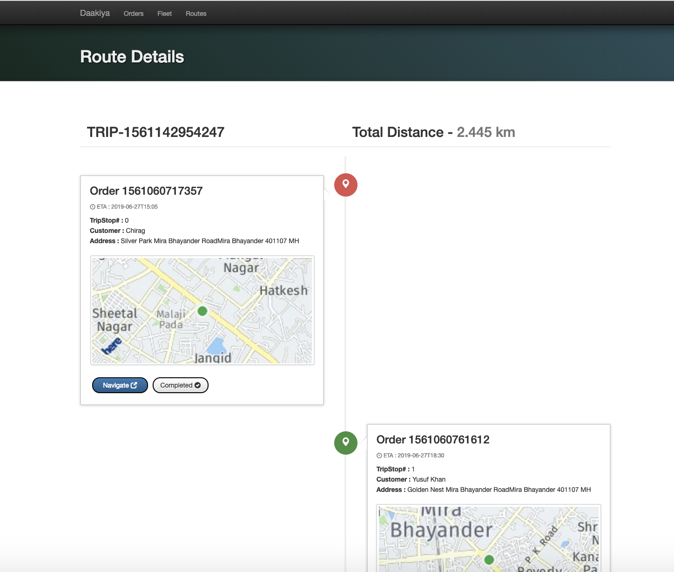

Slide 11
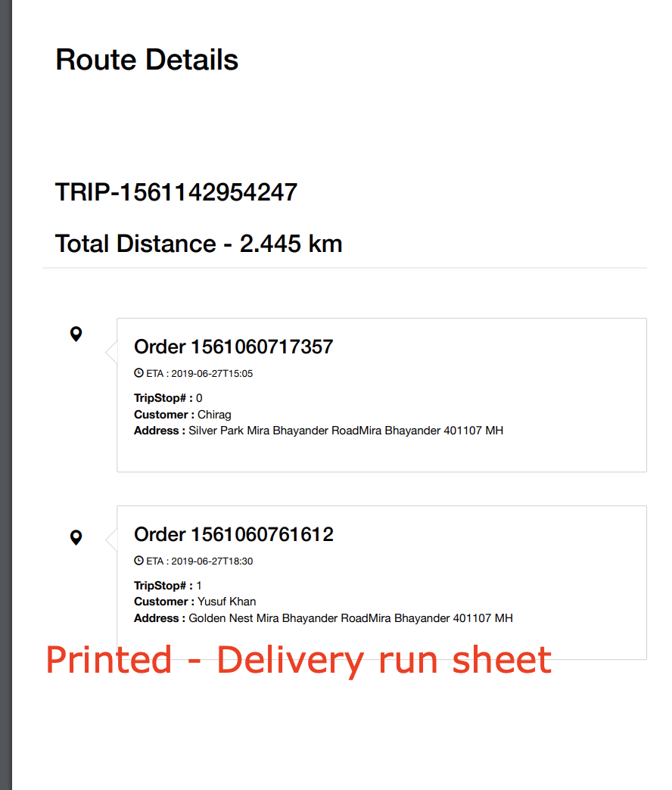

Slide 12
HERE Services Involved
HERE Geocoding API
HERE Places API
HERE Routing API
HERE Waypoints API
HERE Map Image API
HEREWeGo (Web and Mobile)
HERE XYZ Studio
HERE XYZ Hub API

Slide 13
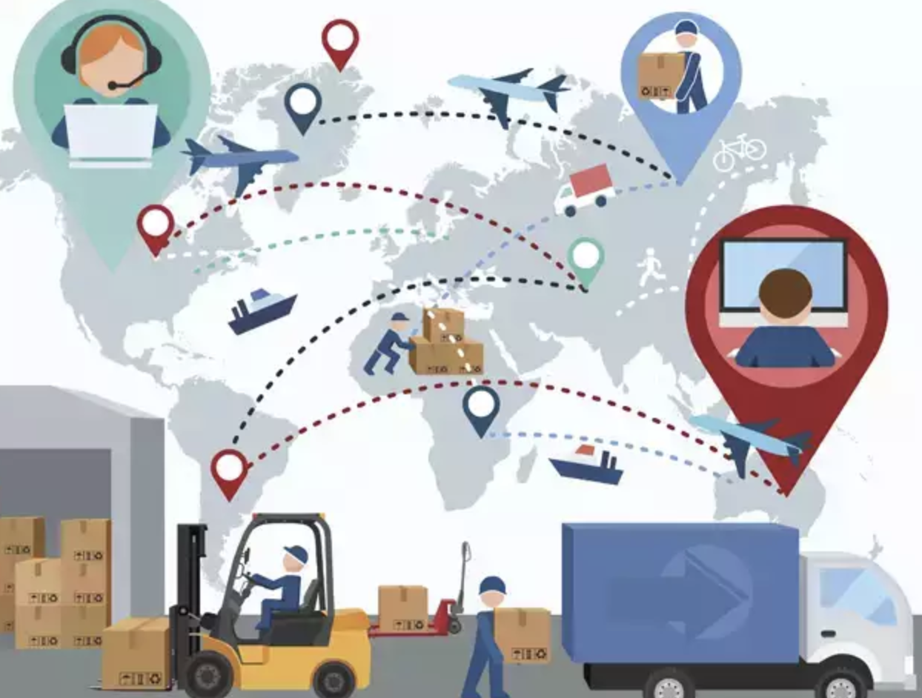
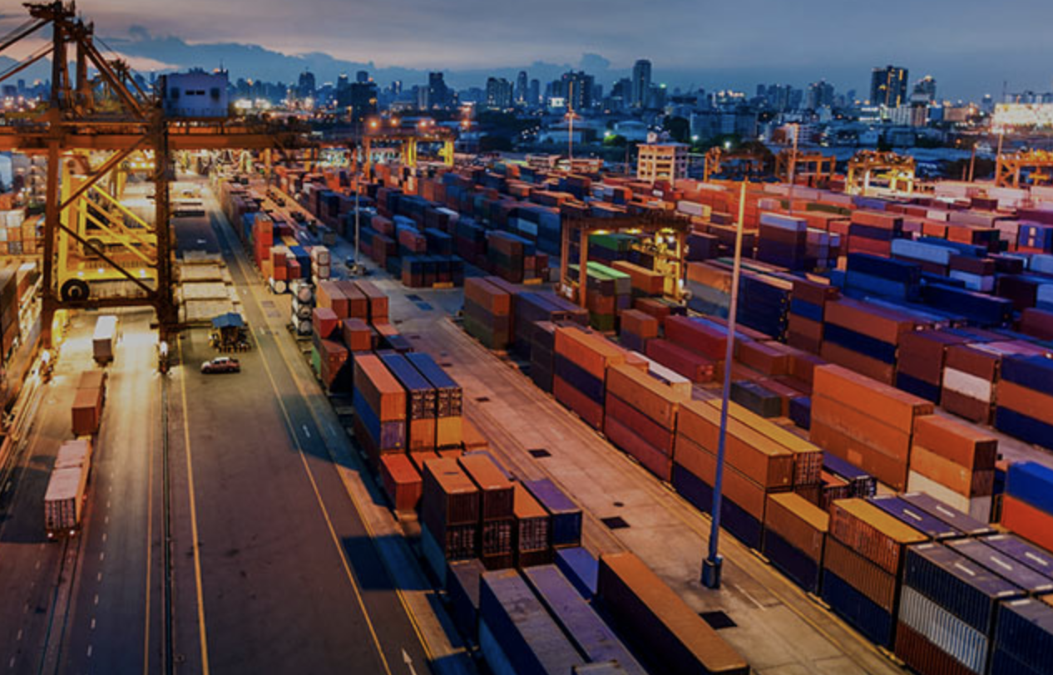
Logistics is complex
Everything around you has a logistics backbone around it
Enterprises work hard to get things around you, in variety of ways
But its not easy for them to do that everyday

Slide 14
Problem
Logistics and Supply chain last mile deliveries
Should be able to find the optimized route for a given orders dataset
Should be able to consider key factors in like traffic, capacity for delivery associate and location preference for delivery agent
Analyze and monitor the progress for each order deliveries

Slide 15
Features Covered
Ability to add orders and create a route plan
Ability to plan and routes based on delivery times for all Last Mile deliveries considering a given time frame
Ability to add delivery associates and assign tracking
Integrations with HERE Tracking for delivery tracking and HERE XYZ for data storage
Ability to share, print existing route created from this system to HEREWeGo Mobile App

Slide 16
Technologies used
Front End
HTML, CSS, JavaScript,
jQuery
Firebase Hosting
Backend
HERE XYZ Spaces
Firebase Cloud DataStore
Firebase Authentication
Firebase Cloud Functions

Slide 17
Impact Analysis
System can be used in places for last mile delivery optimization in Logistics Domain which includes industries from
Postal Services
Courier partners 3PL (3rd Party Logistics)
FMCG Industries – (Fast Moving Consumer Goods, Eg. DMart)
Food Delivery Partners (eg. Swiggy, Zomato, McDondals)

Slide 18
Prototype Link
https://github.com/deadnight7/daakiya/
Hosted Site link:
https://a-positronium.firebaseapp.com

